Slide 1
Connecting to a DB

Slide 2

Server Side Scripts – Content
Data Storage Request
Order submission
Contact form
Data Retrieval Request
Order status
Login
Business analytics

Slide 3
Server Side Connection to a DB
HTML Form gets user input and submits
Script parses the information
User receives information that the script generated
Script establishes DB connection
Script performs activities in DB
Server Side Scripting Lesson
Current Lesson
Next Lesson

Slide 4
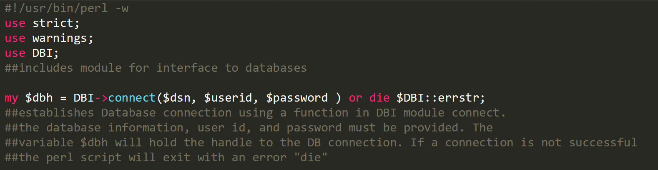
How a DB Connection is Established

Slide 5
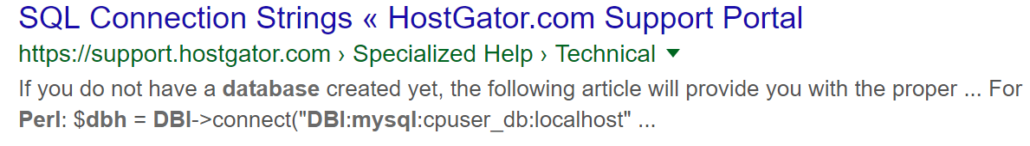
DB Connection Details
The way to connect to a DB might be different across host providers and service plans within those. Information needs to be looked up.

Slide 6
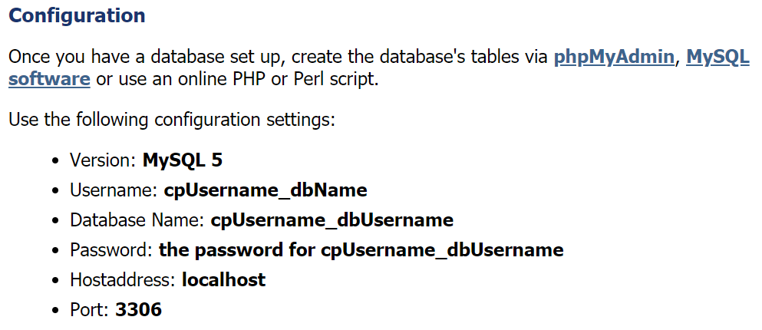
Hostgator DB Connection Details
Hostgator offers 2 examples of how its possible to access DB on their server

Slide 8
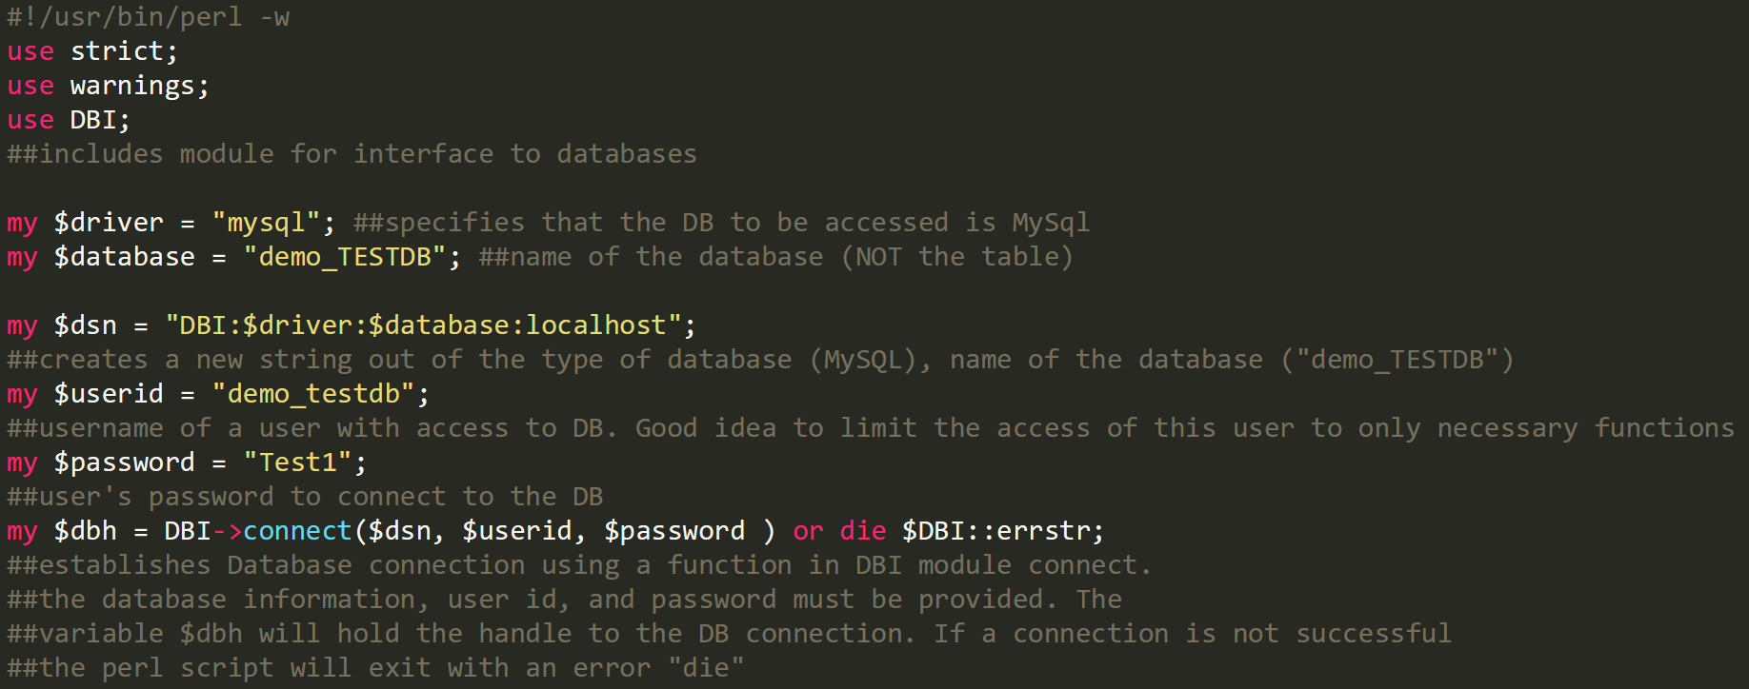

Slide 9
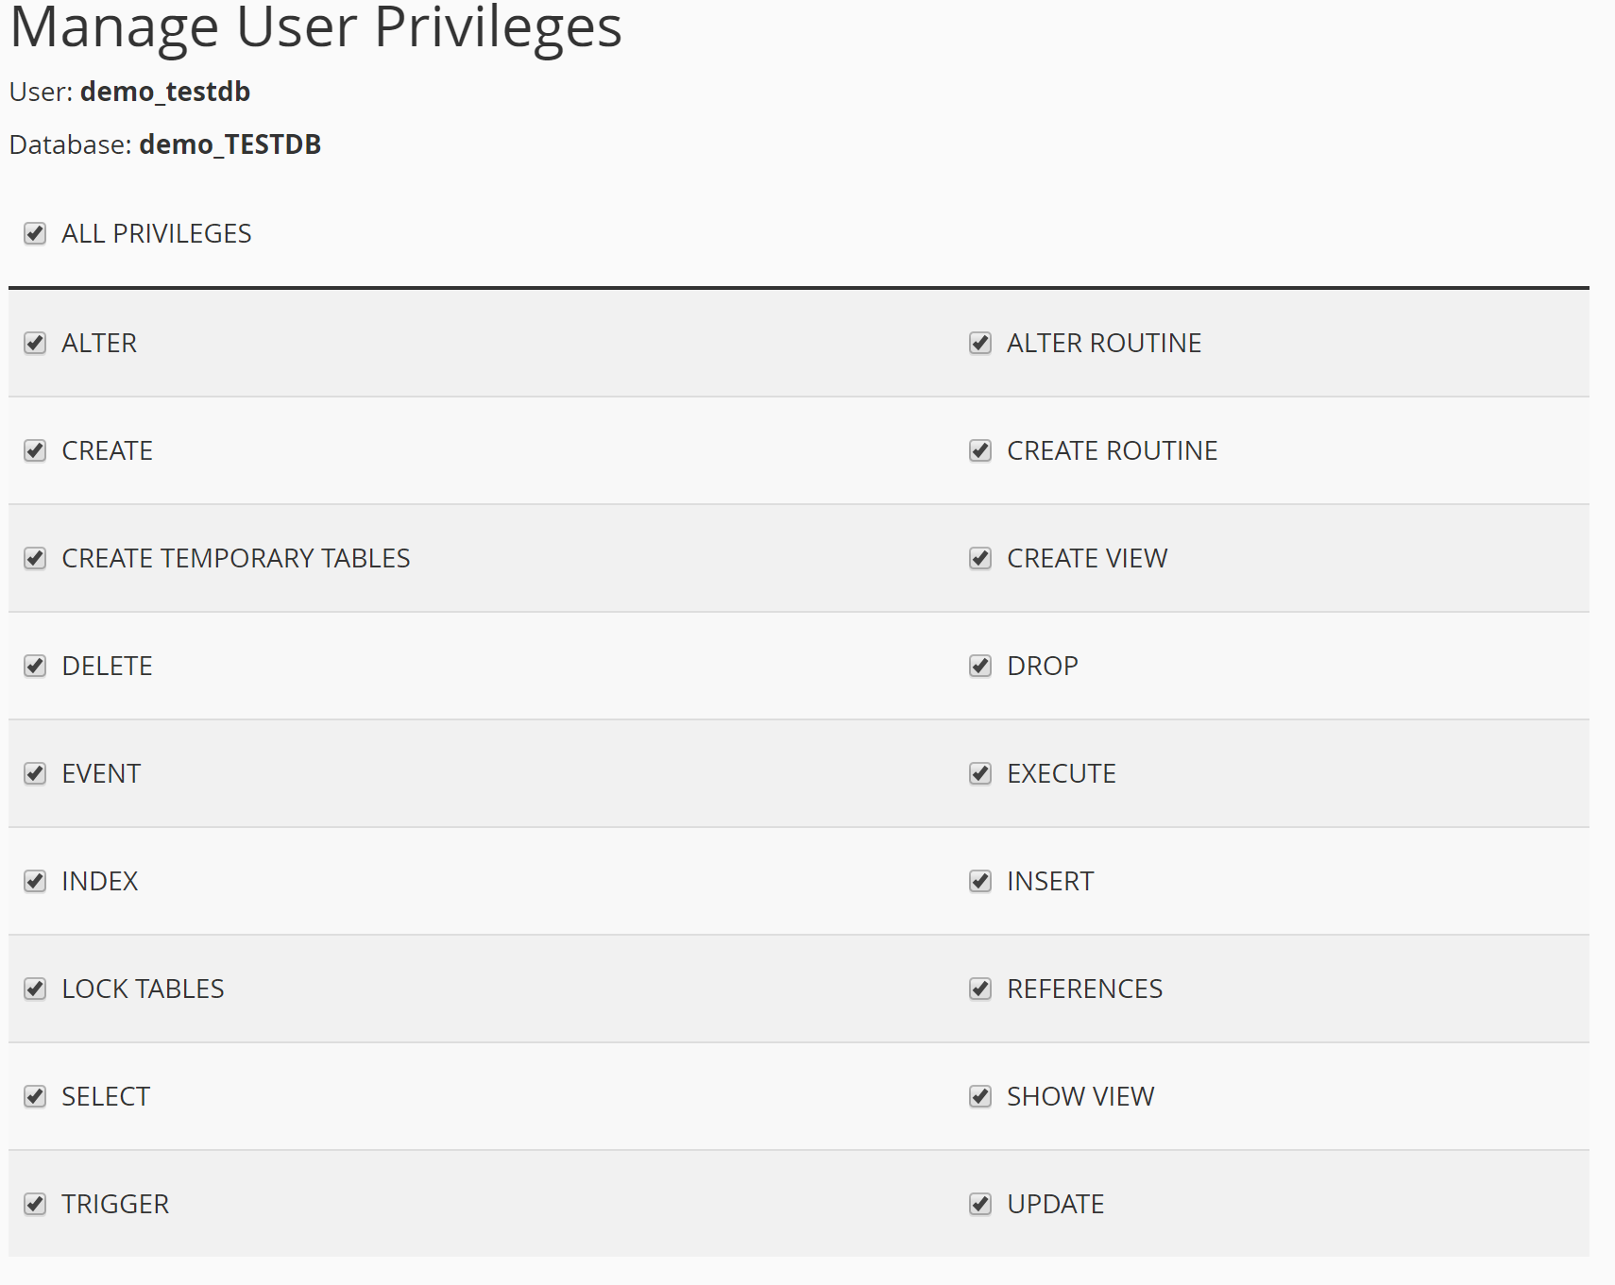
Ensuring correct user permissions
Limit users to permissions that are required to perform the necessary task

Slide 10
DB Connection Tutorial
Create a database called: Contact_Information
For the database, create a user: contactus
For the user contact_us_form, create a password: password
Take the perl script (db_connection_example1.pl) and change the variable definitions as appropriate for the newly created database
Double check your actual DB name. There might be a prefix before the name you designated
Double check your username.
Create an html form that will POST data to the perl script
Observe the results!
Notes:
Create form: db_connection_form.html and transfer to new Perl folder to Hostgator
Create Perl file for connecting and place to cgi-bin

Slide 11
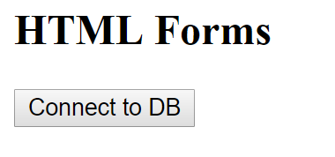
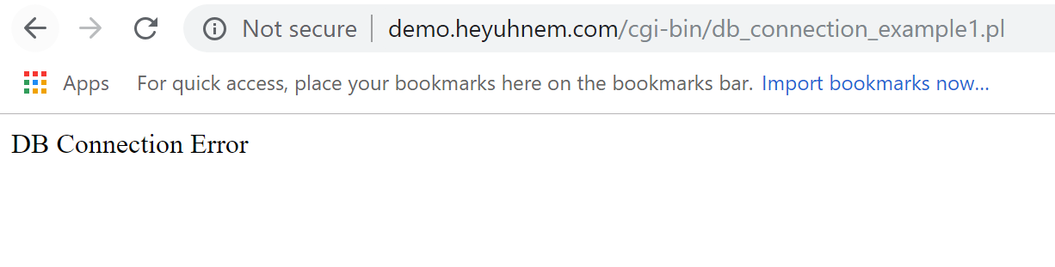
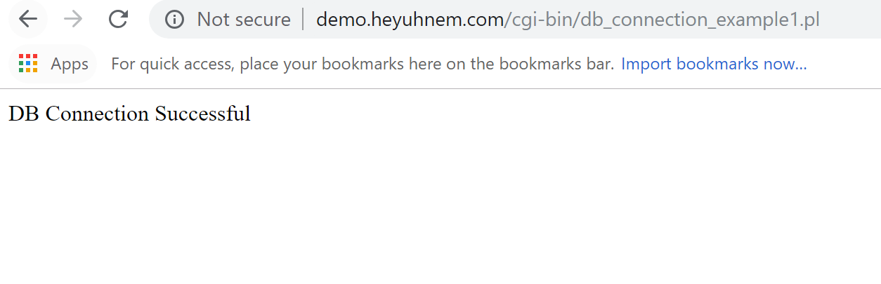
Result
Properly Connected
Improperly Connected
Link

Slide 12
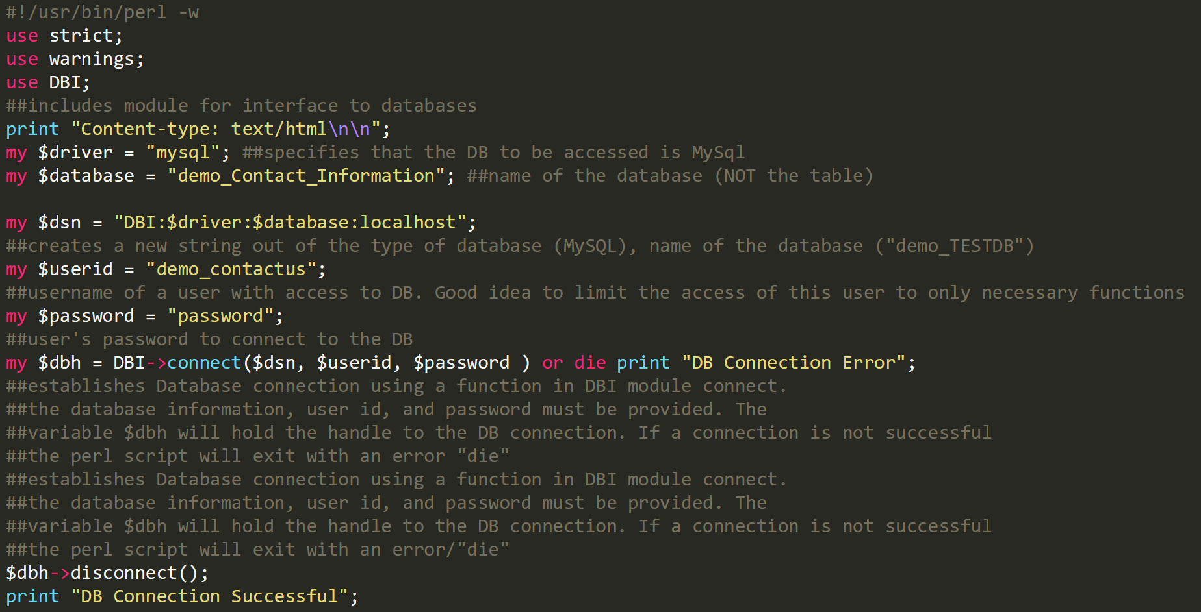
Username of account was “demo”
if connection not successful,
script dies and prints an error
If we got here, means connection was successfully made. If you don’t
Disconnect from DB, second print message will not be visible

Slide 13
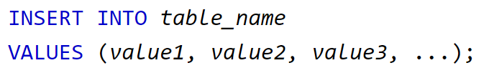
Adding data to the database Workflow
A DB connection, gives access to the database console
An INSERT statement needs to be generated in order to add data to the database using a server side script
INSERT statement needs to be executed
DB connection needs to be closed (disconnected)
Notes:
Create DB “simple” with user and password

Slide 14
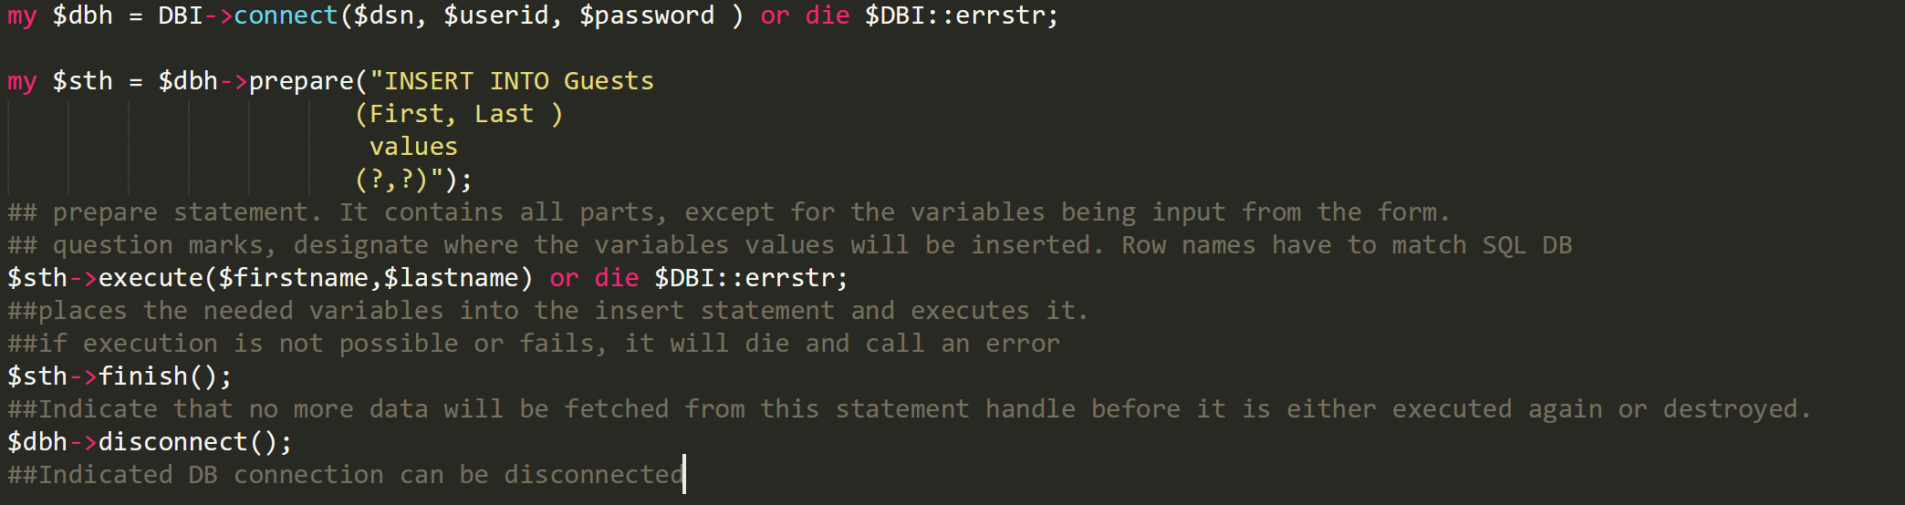
Perl Statement Generation

Slide 15
Take a look at an example
2 Files in Example 2 (HTML Form and Perl Script)
demo.heyuhnem.com/simple_form_db.html

Slide 16
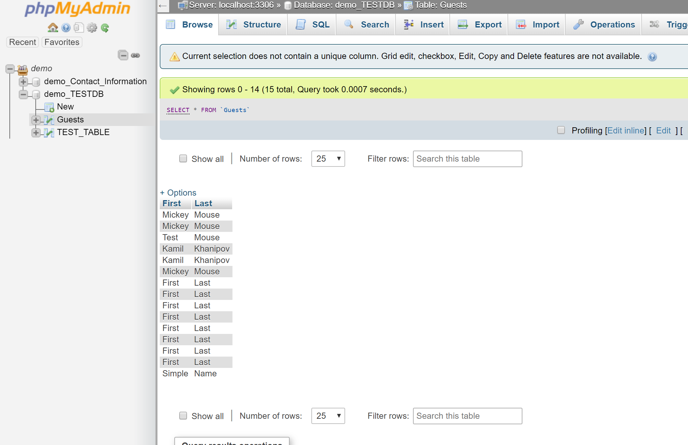
DIY
Create a table within your database with 2 VARCHAR columns:
First
Last
Change the login details in the perl example file
Launch the html form and the perl script on hostgator
Perform form submissions and track if the data is getting added
Go to Cpanel on Hostagator
Go to phpMyAdmin under databases
Navigate to the right database and table to see what is in it

Slide 17
DIY: Make the Jump
Create a database for the form you were working on before
4 input fields: First Name, Last Name, Email and Phone
Take the form_extended.html (don’t forget to change action attribute of the form element to submit to the correct perl script)
Create a Perl Script to take the data and parse it
Insert the data into your MySQL database
Print a message at the end of the script, stating that the connection has been made and data added.
Submit to all files used and screenshot of database content

